Slide 1
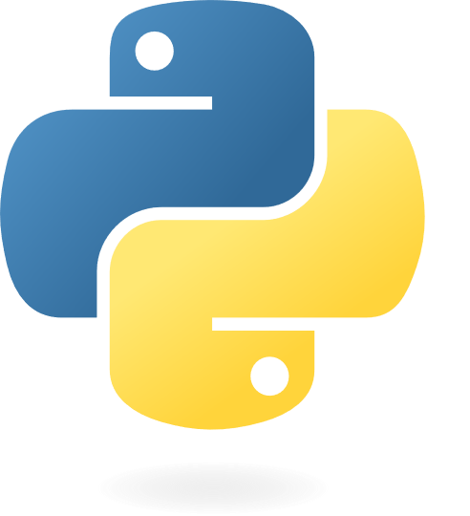
Soaring Through Data: An Introduction to Python for Data Analysis
Sue Bayes

Slide 2

Sue Bayes
Power BI developer
Own business
Data everything
www.databayes.co.uk
https://www.meetup.com/devon-and-cornwall-power-bi-meetup-group/
Microsoft Data Platform MVP

Slide 3
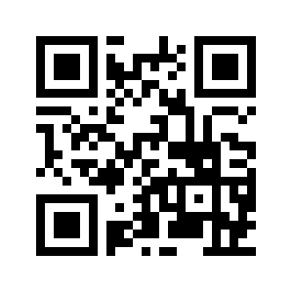
Aim
To know how to use Python
with notebooks
in Fabric

Slide 4
Flight Plan
Introduction
Python basics
Libraries – NumPy & Pandas
Data cleaning examples
Visualisation
Libraries – Matplotlib & Seaborn
Break
Data Wrangler
Case Study & ChatGPT

Slide 5
Python
Python is a versatile tool for solving a wide range of problems, from creating websites and apps to analysing data and making predictions with artificial intelligence.
Libraries are central to this ability
It's easy to learn and use, making it popular for everything from automating small tasks on your computer to powering complex technologies behind the scenes.

Slide 6
Demo
Notes:
Add Workspace
Show Link to OneLake - Download OneLake file explorer from Official Microsoft Download Center
Open File Explorer
HR.csv
Open Anaconda
Intro to Python
Part Two
Recap
Data Wrangler examples – anaconda – ipython
Garmin api
Examples

Slide 7
Flight Plan
Introduction
Python basics
Libraries – NumPy & Pandas
Data cleaning examples
Visualisation
Libraries – Matplotlib & Seaborn
Break
Data Wrangler
Case Study & ChatGPT

Slide 8
Demo

Slide 9
Flight Plan
Introduction
Python basics
Libraries – NumPy & Pandas
Data cleaning examples
Visualisation
Libraries – Matplotlib & Seaborn
Data Wrangler
Case Study & ChatGPT
Questions?

Slide 10
Aim
To know how to use Python, notebooks and Fabric

Slide 11
Q & A
Feedback
https://sqlb.it/?10904

Slide 12
Resources
https://github.com/databayes/Python
https://www.w3schools.com/python/python_reference.asp
https://chat.openai.com/
https://learn.microsoft.com/en-us/fabric/data-engineering/how-to-use-notebook

Slide 13
















